Slide 1
Impulse and Momentum in a Rigid Body System
Dr. Jacob Moore
Associate Professor of Engineering
Penn State Mont Alto

Slide 2
Impulse and Momentum in Rigid Bodies
As we have seen before, when we move from particle systems to rigid body systems, we will need to not only deal with forces, positions, velocities, and accelerations, but we will also need to deal with moments, orientations, angular velocities, and angular accelerations.
This remains the case with impulse-momentum methods, where we will add an angular counterpart to impulse as well as an angular counterpart to momentum

Slide 3
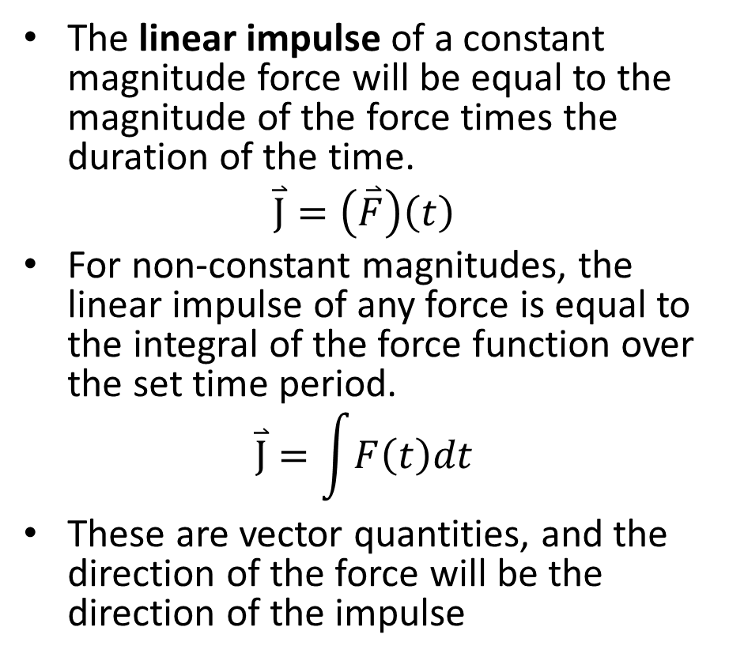
Linear Impulse (review)
The linear impulse of a constant magnitude force will be equal to the magnitude of the force times the duration of the time.
$$\overset{⃑}{J}=\left(\overset{⃑}{F}\right)\left(t\right)$$
For non-constant magnitudes, the linear impulse of any force is equal to the integral of the force function over the set time period.
$$\overset{⃑}{J}=\int{F\left(t\right)dt}$$
These are vector quantities, and the direction of the force will be the direction of the impulse
Force
(kN)
Time
(s)

Slide 4
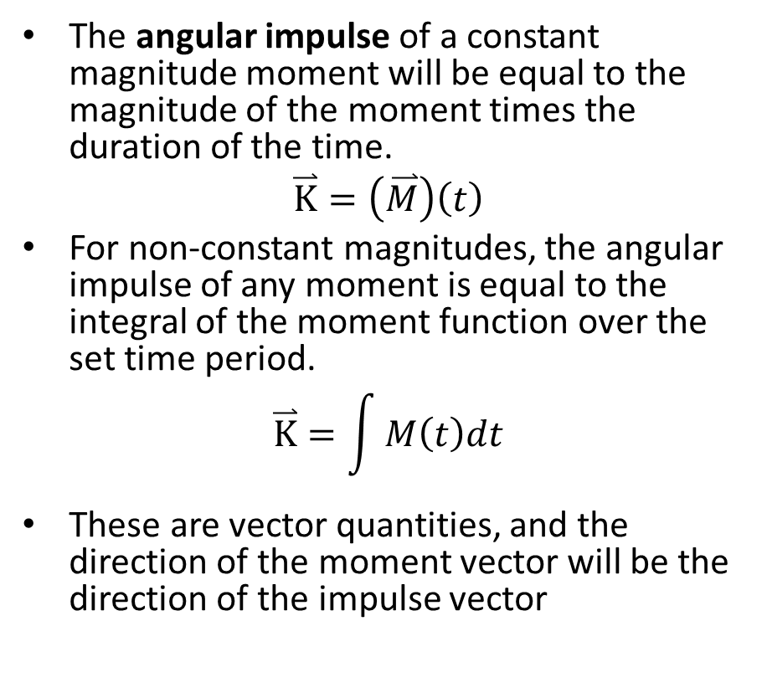
Impulse of a Moment
The angular impulse of a constant magnitude moment will be equal to the magnitude of the moment times the duration of the time.
$$\overset{⃑}{K}=\left(\overset{⃑}{M}\right)\left(t\right)$$
For non-constant magnitudes, the angular impulse of any moment is equal to the integral of the moment function over the set time period.
$$\overset{⃑}{K}=\int{M\left(t\right)dt}$$
These are vector quantities, and the direction of the moment vector will be the direction of the impulse vector
Moment
(kN m)
Time
(s)

Slide 5
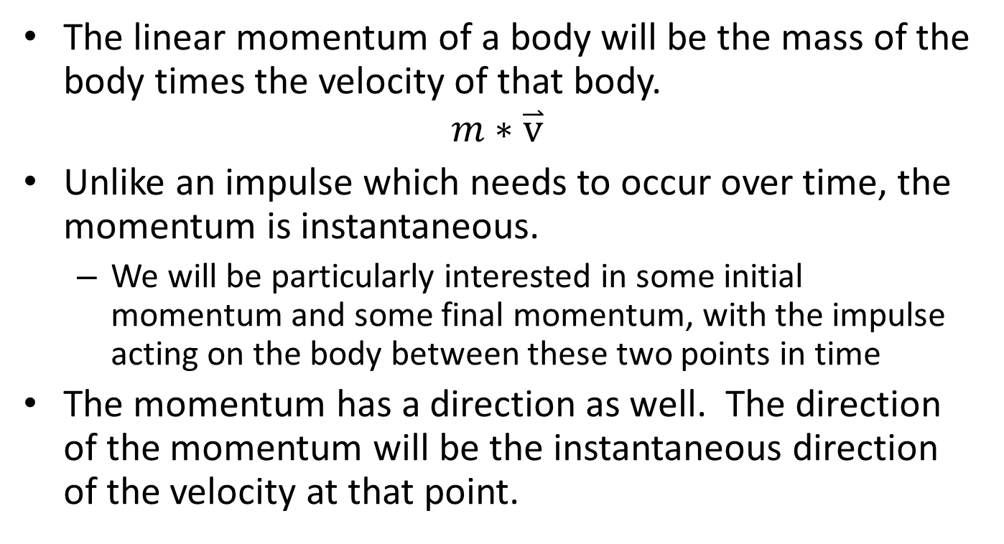
Linear Momentum (review)
The linear momentum of a body will be the mass of the body times the velocity of that body.
$$m∗\overset{⃑}{v}$$
Unlike an impulse which needs to occur over time, the momentum is instantaneous.
We will be particularly interested in some initial momentum and some final momentum, with the impulse acting on the body between these two points in time
The momentum has a direction as well. The direction of the momentum will be the instantaneous direction of the velocity at that point.

Slide 6
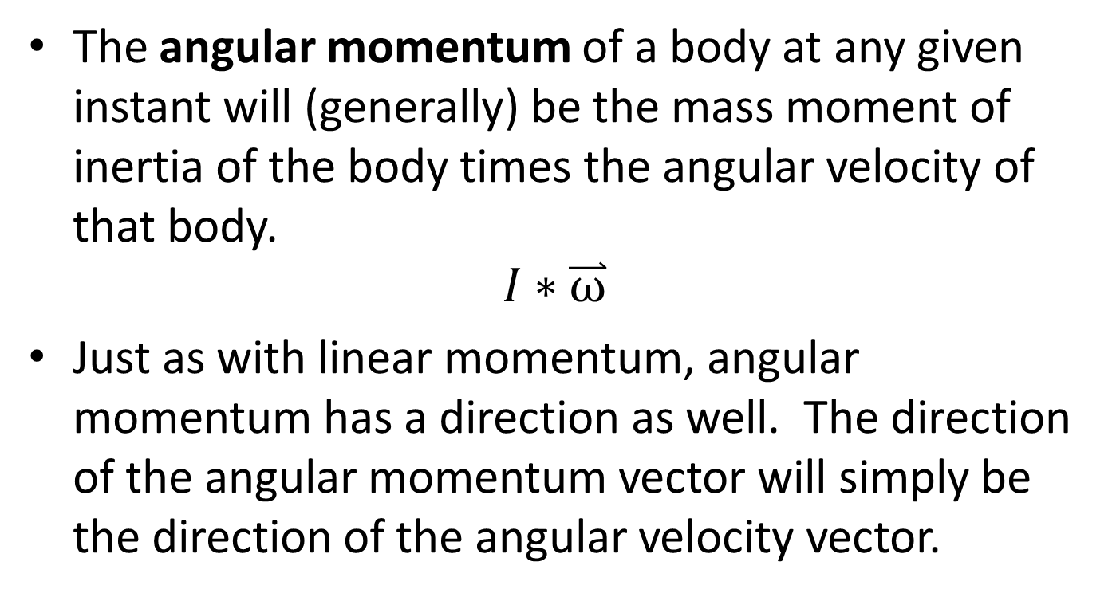
Angular Momentum
The angular momentum of a body at any given instant will (generally) be the mass moment of inertia of the body times the angular velocity of that body.
$$I∗\overset{⃑}{ω}$$
Just as with linear momentum, angular momentum has a direction as well. The direction of the angular momentum vector will simply be the direction of the angular velocity vector.

Slide 7
Angular Momentum
Complicating matters with angular momentum, is the fact that angular momentum will depend upon the point we are calculating it about.
Unlike linear momentum which is a single value, the angular momentum has many possible magnitudes depending on the point of interest we choose.
We can technically take the angular momentum about any point, though we will usually take the angular momentum about one of four points.
The center of mass of the body
A fixed axis of rotation
The instantaneous center of zero velocity
The point of impact in a collision

Slide 8
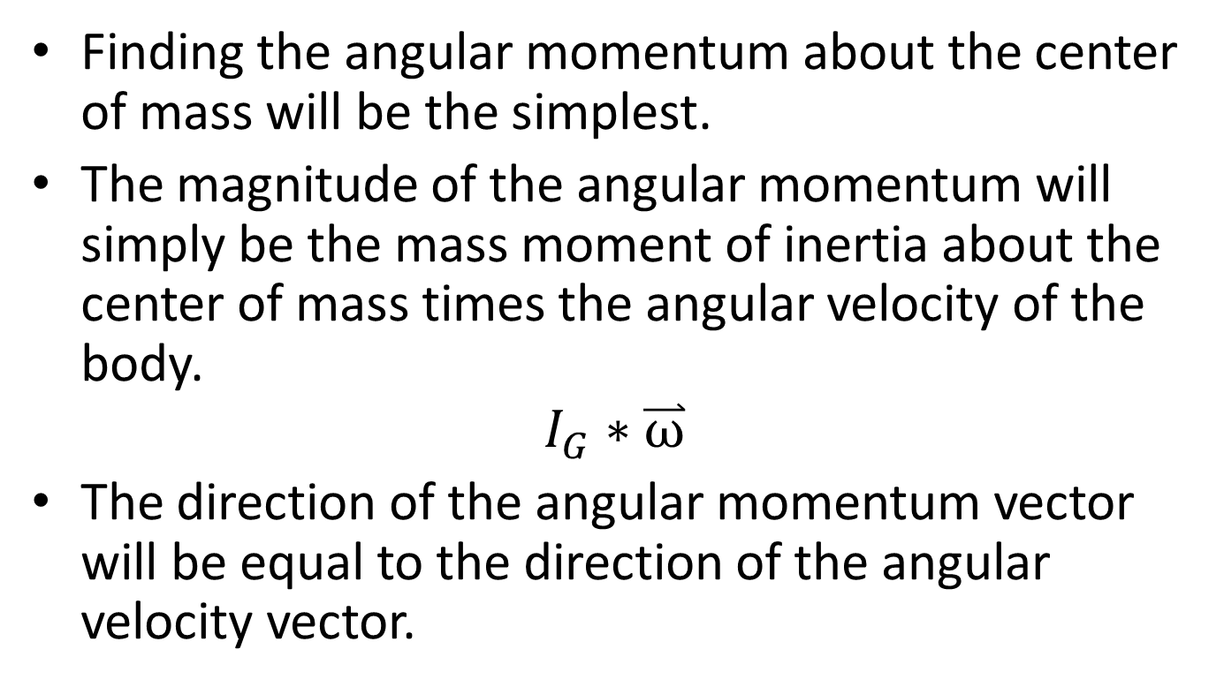
Angular Momentum About the Center of Mass
Finding the angular momentum about the center of mass will be the simplest.
The magnitude of the angular momentum will simply be the mass moment of inertia about the center of mass times the angular velocity of the body.
$$I_{G}∗\overset{⃑}{ω}$$
The direction of the angular momentum vector will be equal to the direction of the angular velocity vector.

Slide 9
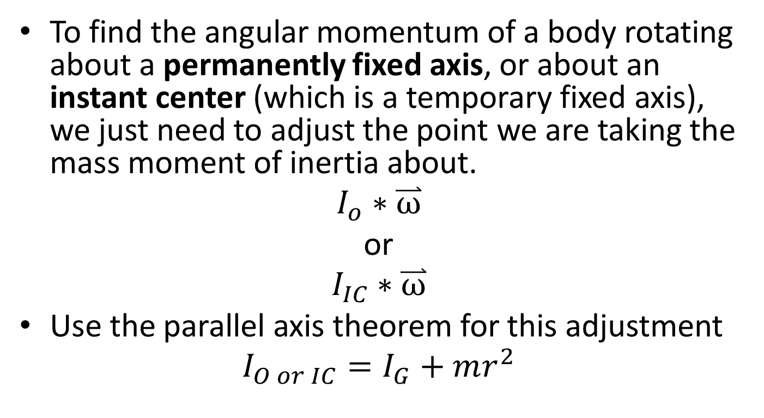
Angular Momentum about a Fixed Axis or the Instant Center
To find the angular momentum of a body rotating about a permanently fixed axis, or about an instant center (which is a temporary fixed axis), we just need to adjust the point we are taking the mass moment of inertia about.
$$I_{o}∗\overset{⃑}{ω}$$
or
$$I_{IC}∗\overset{⃑}{ω}$$
Use the parallel axis theorem for this adjustment
$$I_{O or IC}=I_{G}+mr^{2}$$

Slide 10
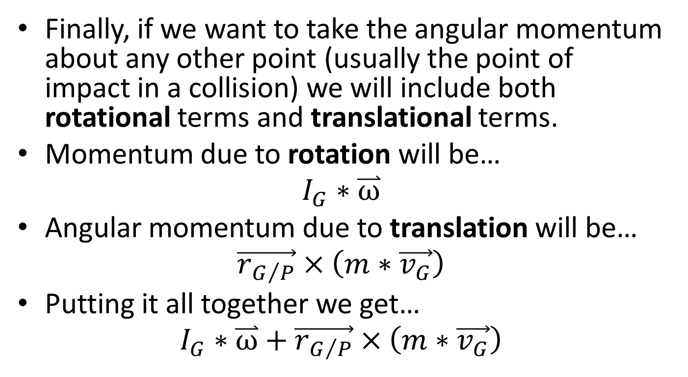
Angular Momentum About Any Other Point
Finally, if we want to take the angular momentum about any other point (usually the point of impact in a collision) we will include both rotational terms and translational terms.
Momentum due to rotation will be…
$$I_{G}∗\overset{⃑}{ω}$$
Angular momentum due to translation will be…
$$\vec{r_{G/P}}×\left(m∗\vec{v_{G}}\right)$$
Putting it all together we get…
$$I_{G}∗\overset{⃑}{ω}+\vec{r_{G/P}}×\left(m∗\vec{v_{G}}\right)$$

Slide 11




Angular Momentum About Any Other Point
$$I_{G}∗\overset{⃑}{ω}+\vec{r_{G/P}}×\left(m∗\vec{v_{G}}\right)$$
Mass Moment of Body About the Center of Mass
Displacement Vector from Point of Interest (P) to Center of Mass of Body (G)
Angular Velocity of Body
Velocity Vector of Body at Center of Mass
Mass of Body
P
$$\overset{⃑}{ω}$$
$$\vec{r_{G/P}}$$
G
$$\vec{v_{G}}$$

Slide 12
Thanks for Watching
See other engineering mechanics videos and access the full tool at…

Slide 13
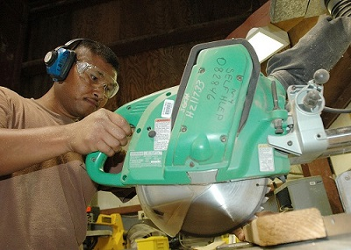
Worked Example
A miter saw has an operating speed of 1500 rpm. The blade and motor armature have a combined weight of 3 lbs and a radius of gyration of 1 inch.
What is the time required for the bearing friction alone (T=.015 in lbs) to stop the blade?
What is the torque a braking system would need to apply to stop the blade in just .25 seconds?
Public domain image by John F. Looney

Slide 14
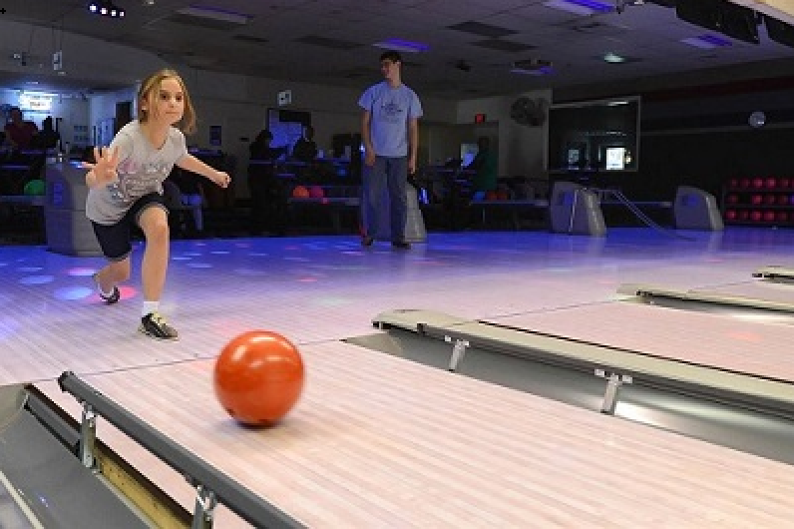
Worked Example
A bowling ball is modeled as a 7 kg uniform sphere 300 mm in diameter. The ball is released with an initial velocity of 6m/s on a horizontal wooden floor (𝜇_{k}=.1) with zero angular velocity.
How long does it take before the ball begins to roll without slipping?
What is linear velocity of the ball at this time?
Public domain image by Jerry Saslav

Slide 15
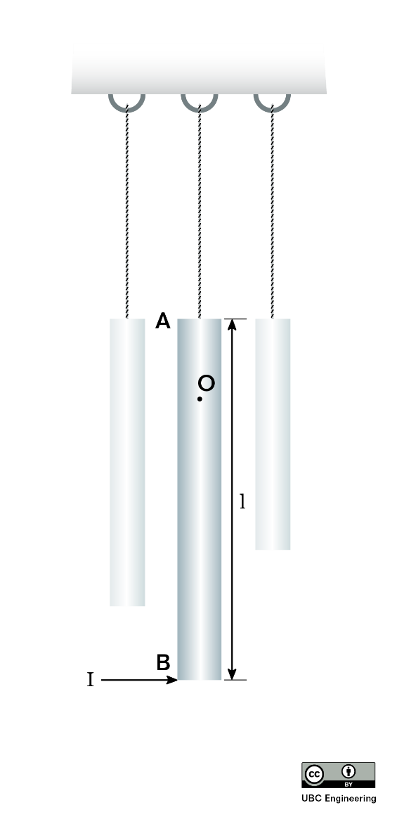
Worked Example
A windchime consists of several slender rods, each suspended on one end by a rope and each with mass m. Consider a singular rod for this problem. As the wind blows, the rod is subjected to an impulse I at its bottom. Determine the vertical location of point O in which the rod appears to rotate.

Slide 16
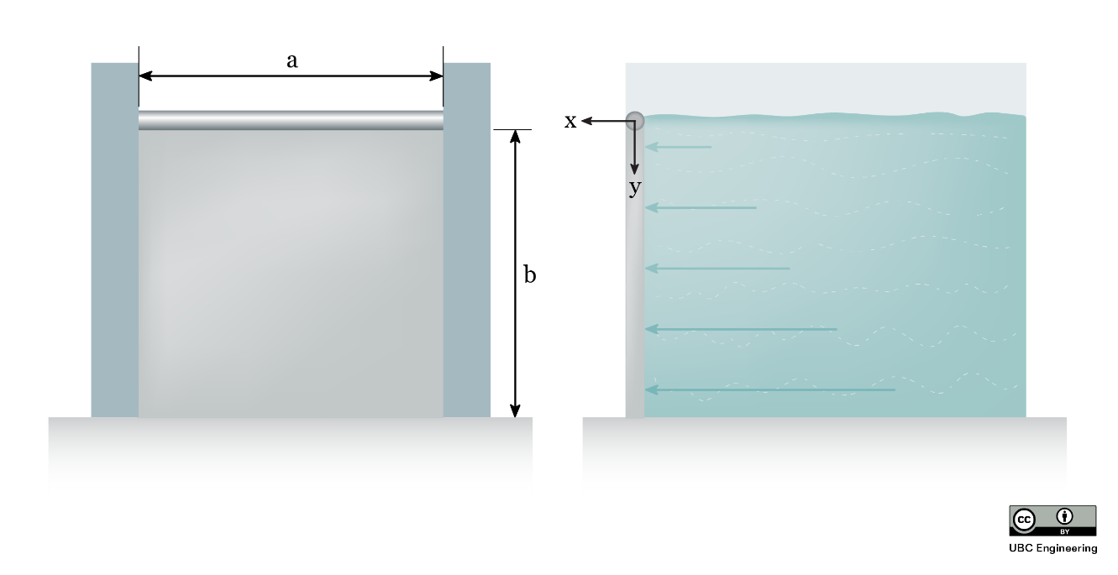
Worked Example
A salmon hatchery has a gate to release water whenever water levels get too high. The gate is normally locked into place, but when the water reaches. The top of the gate, the lock is instantly removed. While the water would flow out of the gate by itself, there is a pump located upstream from the gate to push water forward. The pump is old, so its power slowly ramps up with time. The gate consists of a slender rod in which a 20 kg thin plate is attached. The plate has dimensions a=1.5 m,b=2 m and rotates about the slender rod as if it were a pin. Although there is a seal such that water may not get out, assume the contact between the plate and other surfaces is frictionless. If the gate is subject to water from the pump that applies a force distribution with a magnitude that is related to both the y-coordinate and time dF=(-t(y-2)^2+8t) dy N, determine the angular velocity of the gate after t=2 seconds if the gate initially starts at rest.

Slide 17
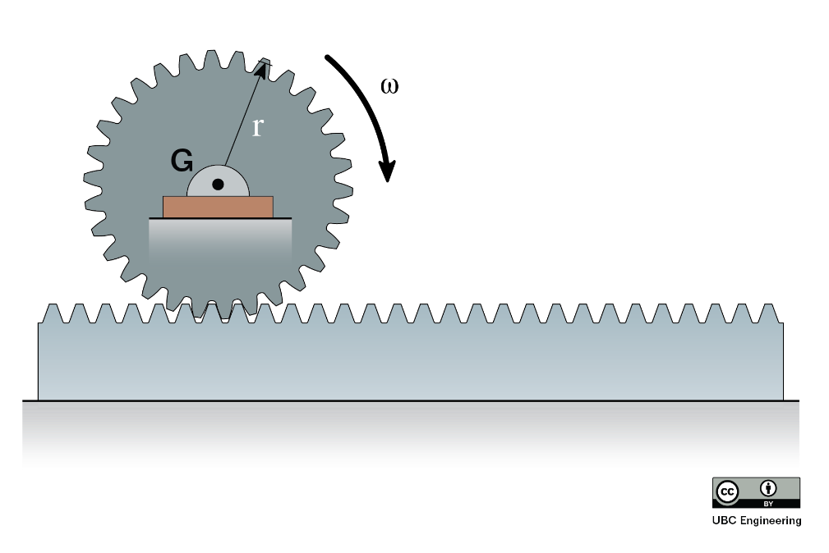
Worked Example
A city engineer is working on a cargo transport system utilizing gears and racks. She is considering a 30 kg gear with a radius of gyration of k_{G} = 125 mm and a radius of r = 0.15 m. The gear is in contact with a 20 kg rack. If it takes the gear 0.6125 s to reach an angular velocity of ω = 20 rad/s, starting from rest, determine the moment that the gear is subjected to. Assume there is no friction between the rack and the ground.

Slide 18
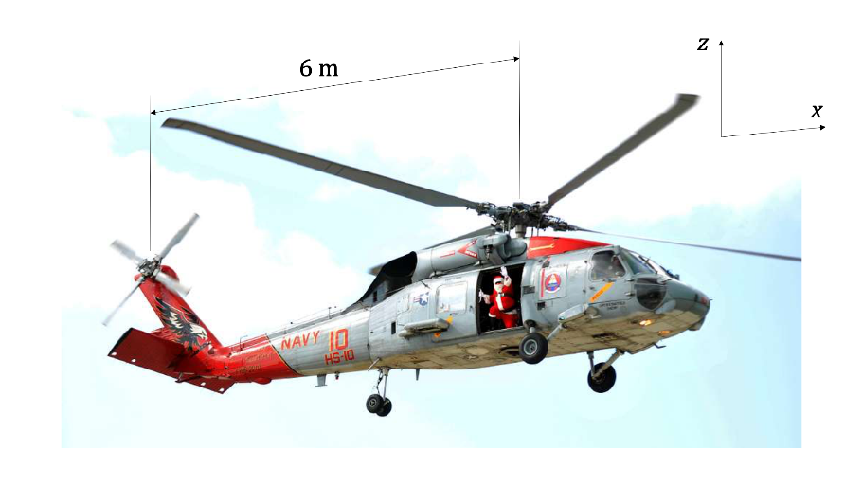
Worked Example
A helicopter tail rotor is used to prevent unwanted rotation of the body of the helicopter when the main rotor changes speed. Assume that the four main rotor blades are each long thin rods with length of 5 m and mass of 30 kg. Assume that the helicopter body has a mass of 750 kg and a mass moment of inertia of 1300 kg-m² at its center of gravity, located vertically in line with the main rotor. The distance between the main and tail rotors is 6 m.
If the tail rotor is functioning, and the angular velocity of the helicopter body remains at zero before and after the main rotor changes speed from 200 rpm to 300 rpm, find the final horizonal velocity of the helicopter body (starts from rest).
Assuming the main rotor change in speed from 200 rpm to 300 rpm occurs in uniformly over 8 s, find the force exerted by the tail rotor to keep the helicopter body from turning.

